Slide 1
CONTENTS
Introduction
Literature Survey
Problem Statement
Existing System
Proposed System
System Architecture
Objective
Scope
Plan of work
References

Slide 2
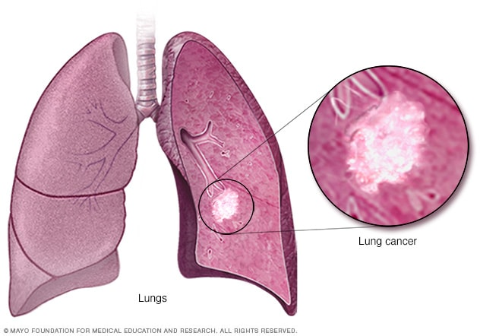
INTRODUCTION
Lung cancer is a type of cancer that begins in the lungs. Your lungs are two spongy organs in your chest that take in oxygen when you inhale and release carbon dioxide when you exhale.
Lung cancer is the leading cause of cancer deaths worldwide.
Signs and symptoms of lung cancer may include:
A new cough that doesn't go away
Coughing up blood, even a small amount
Shortness of breath
Chest pain
Hoarseness
Losing weight without trying
Bone pain
Headache

Slide 3
INTRODUCTION
New technologies, like AI and radiomics, are helping doctors better understand tumors and improve predictions.
Computers, especially CNNs, are becoming really helpful in studying cancer slides, making it quicker and less prone to errors compared to traditional methods.
Cancer in the lungs is a big problem and can be deadly.
It's hard to spot lung cancer early because we often notice it when it's already a big issue.
Even though we're getting better at treating some cancers, progress is slow for lung cancer.
Smart computers are helping doctors by looking at special pictures inside our bodies (like X-rays) to learn more about the cancer.
These smart computers also help doctors look at tiny pieces of tissue really quickly, making it easier for them to figure out the best way to treat the cancer.

Slide 4
LITERATURE SURVEY
Paper Title | Authors | Year | Algorithm Used | Overview | Drawbacks
Prediction of Lung Cancer using Convolution Neural Networks | Aanchal Vij, Kuldeep Singh Kaswan | 2023 | Convolutional Neural Networks (CNN) | Utilizes Artificial Intelligence on CT scan images to predict lung cancer, employing Deep Learning with CNN for improved accuracy. Dataset includes 1000 chest scans with various lung cancer types (Adenocarcinoma, Large Cell Carcinoma, Squamous Cell Carcinoma). VGG-16 is implemented for severity assessment. | Limited discussion on potential false positives and false negatives in the results raises concerns about the model's reliability in real-world scenarios.

Slide 5
LITERATURE SURVEY
Paper Title | Authors | Year | Algorithm Used | Overview | Drawbacks
Deep Learning Predicts Lung Cancer Treatment Response | Yiwen Xu, Ahmed Hosny | 2020 | Deep Learning Networks | The study evaluates deep learning networks for predicting clinical outcomes by analyzing time series CT images of patients with locally advanced non–small cell lung cancer (NSCLC). | The study may suffer from a relatively small dataset (179 patients in Dataset A), potentially limiting the generalizability of findings.

Slide 6
LITERATURE SURVEY
Paper Title | Authors | Year | Algorithm Used | Overview | Drawbacks
An Evaluation of ML Classifiers for Lung Cancer | Muhammad Imran Faisal, Saba Bashir | 2020 | SVM, C4.5 Decision tree, MLP, NN, NB | The paper evaluates the discriminative power of various classifiers and ensembles for predicting early-stage lung cancer based on symptoms. Gradient-boosted Tree achieved the highest accuracy of 90%. | The choice of evaluation metrics is crucial. The paper only reports accuracy and does not consider other metrics such as precision, recall, or F1-score, it may provide an incomplete picture of the model's performance.

Slide 7
LITERATURE SURVEY
Paper Title | Authors | Year | Algorithm Used | Overview | Drawbacks
Classification and mutation prediction from NSCLC histopathology images | Nicolas Coudary, Paolo Santigo Ocampo | 2019 | Inception V3 | The study employs deep learning (Inception V3) on histopathology images to classify lung tumors into adenocarcinoma (LUAD), squamous cell carcinoma (LUSC), or normal lung tissue. It also predicts mutations in ten common genes. The model's AUC is comparable to pathologists (0.97). | The model may not work as well in different situations or with different groups of patients. There are ethical concerns about patient privacy and potential biases in the data used to train the model that are not clearly addressed.

Slide 8
PROBLEM STATEMENT
1. Lung cancer is often found too late, limiting treatment options. We urgently need better ways to catch it early.
2. Looking at lung scans manually takes too much time. Using smart computers (Convolutional Neural Networks) can help quickly and accurately identify signs of lung cancer for faster and more effective treatment.

Slide 9
EXISTING SYSTEM
The VGG-16 model produces distinct results for the types of Non-Small Cell lung cancer which provides a better picture to check the threat and choose the diagnosis, but the model achieves only 77.62% which is not very effective and can be enhanced using multiple other algorithms so as to have an efficient algorithm.

Slide 10
PROPOSED SYSTEM
Lung Cancer has a severe effect on generation with the growing death rates. It has the second largest death among all the cancer types. As per, the American Cancer Society, it has been surveyed that Lung cancer needs to be diagnosed at an early stage so as to achieve recovery otherwise, recovery is suspected while prediction in late stages. There are multiple ways to detect Lung Cancer with medical Images such as CT scans, MRIs, and X-rays among which CT scan is considered one of most efficient one among these. But instead of manual checkups, automatic detection can help in providing better results. The VGG19 transfer learning model is considered one of the best methods to work on images for prediction. So, this system includes multiple CT Scan images of multiple cancer types such as Lung adenocarcinoma, benign, and squamous cell carcinoma.

Slide 11
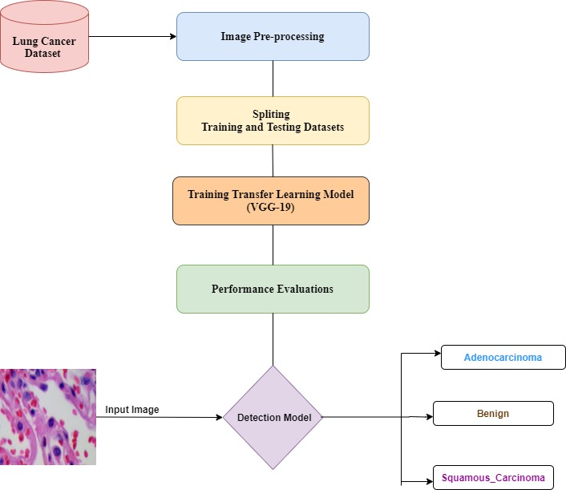
SYSTEM ARCHITECTURE

Slide 12
SYSTEM SPECIFICATIONS
Hardware Requirements:
Processor : Any Update Processor
Ram : Min 4 GB
Hard Disk : Min 250 GB
Software Requirements:
Operating System : Windows family
Technology : Python 3.8
Front-end Technology : HTML, CSS, JS
Back-end Technology : MySQL
Code Development Tool : PyCharm IDE
Web framework : Flask

Slide 13
OBJECTIVES
Improve the accuracy of lung cancer prediction by implementing VGG-19 transfer learning on CT scan images, aiming for a more effective and precise diagnostic tool.
Classify diverse lung cancer types (Adenocarcinoma, Benign, and Squamous Cell Carcinoma) through the VGG-19 model to provide distinct insights into the severity and recommended precautions for each type.

Slide 14
SCOPE
Utilizing VGG19 transfer learning to enhance the accuracy of lung cancer prediction.
Classifying different types of lung cancer for personalized diagnostic insights.
Addressing the limitations of the existing VGG-16 model for improved effectiveness.
Contributing to the advancement of automated, accurate, and personalized lung cancer diagnosis using state-of-the-art deep learning techniques.

Slide 15
PLAN OF WORK
S.NO | MODULE | DURATION
1. | Literature Survey and problem definition | 2 Months
2. | Design | 3 Months
3. | Implementation | 2 Months
4. | Result | 1 Months
5. | Paper Publication and Documentation | 2 Months

Slide 16
REFERENCES
A. Vij and K. S. Kaswan, "Prediction of Lung Cancer using Convolution Neural Networks," 2023 International Conference on Artificial Intelligence and Smart Communication (AISC), Greater Noida, India, 2023, pp. 737-741, doi: 10.1109/AISC56616.2023.10085058.
M. I. Faisal, S. Bashir, Z. S. Khan and F. Hassan Khan, "An Evaluation of Machine Learning Classifiers and Ensembles for Early Stage Prediction of Lung Cancer," 2018 3rd International Conference on Emerging Trends in Engineering, Sciences and Technology (ICEEST), Karachi, Pakistan, 2020, pp. 1-4, doi: 10.1109/ICEEST.2018.8643311.
M.I. Faisal, S. Bashir, Z.S. Khan, F.H. Khan, An evaluation of machine learning classifiers and ensembles for early stage prediction of lung cancer, December, in: 2018 3rd International Conference on Emerging Trends in Engineering, Sciences and Technology (ICEEST), IEEE, 2021

Slide 17
REFERENCES
M. Norouzi and P. Hardy, “Clinical applications of nanomedicines in lung cancer treatment,” Acta Biomaterialia, vol. 121, pp. 134–142, 2021
P. H. Viale, “The american cancer society’s facts & figures: 2020 edition,” Journal of the Advanced Practitioner in Oncology, vol. 11,no. 2, p. 135, 2020.
P.K. Sethy, S.K. Behera, Detection of coronavirus disease (covid-19) based on deep features, Preprints, 2020, p. 2020, 2020030300

Slide 18
Thankyou!

